Slide 1




DIBBs Brown Dog Index and Retrieve

Slide 2
Outline – Indexing Files in a Folder
The Problem: lots of files, need indexing
A bit of BrownDog Architecture
Overview of Code
Hands-On

Slide 3
Indexing Example
Problem: Given a collection of images with embedded text or human features (face, eyes, profile, close-up), search images files based on content.
Solution
Use Brown Dog Service to extract searchable tags from the images and index the collection for quick retrieval
Use BD Client Python Library

Slide 4

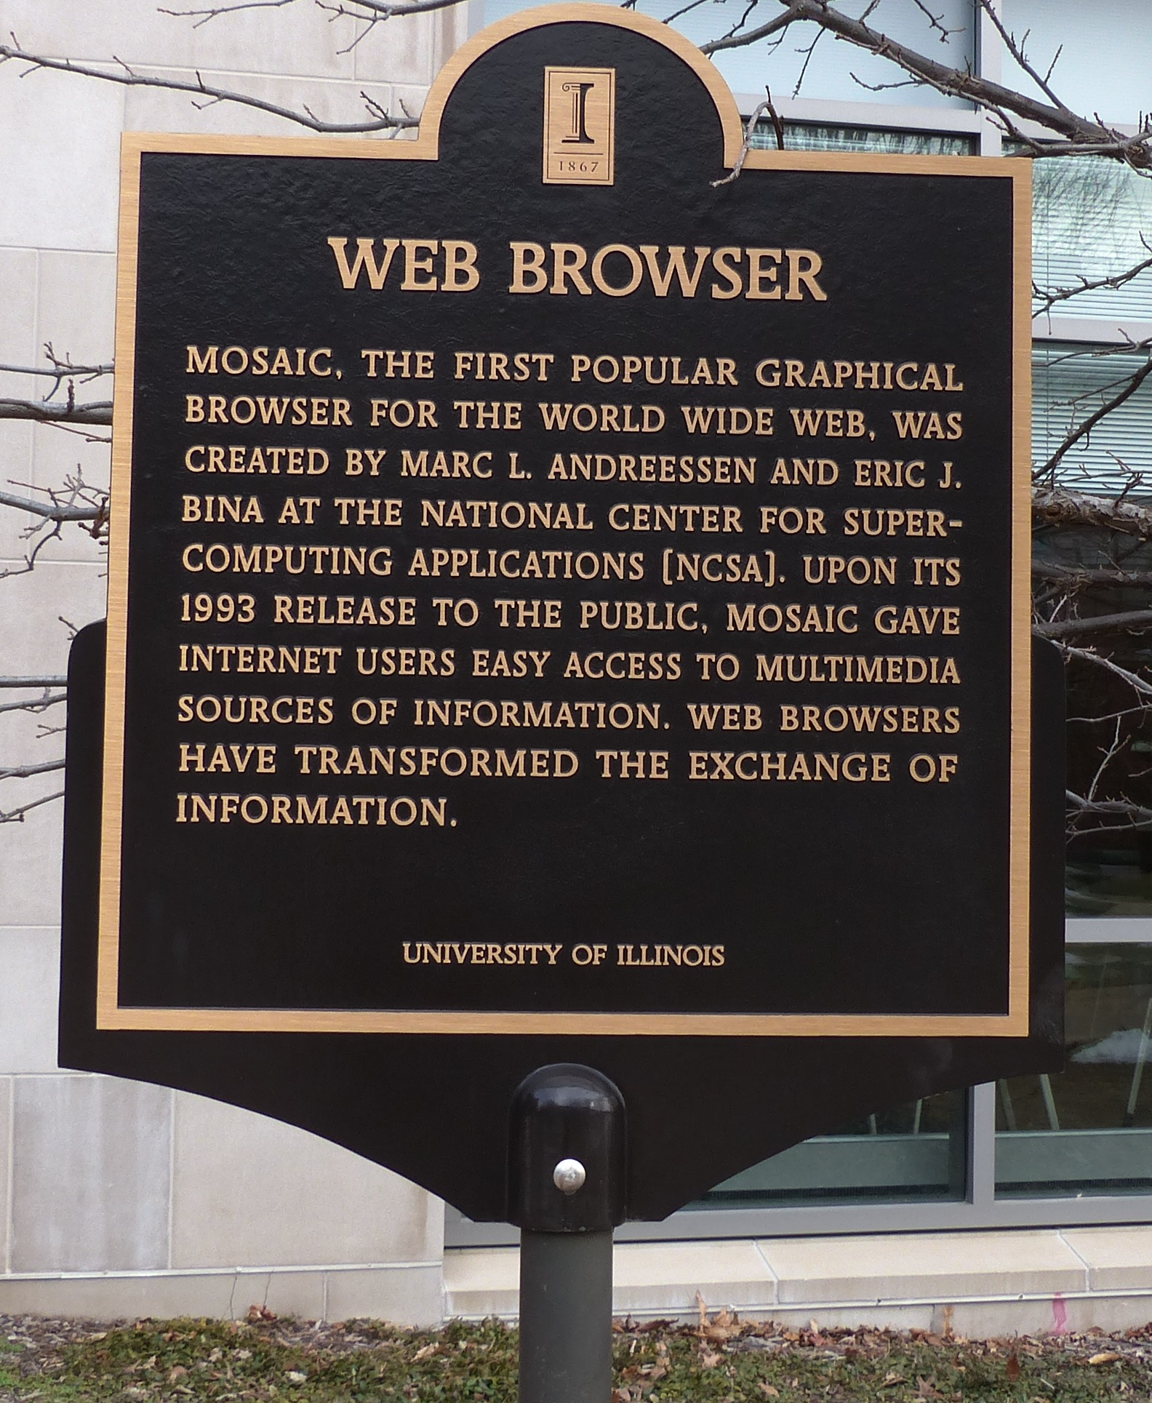


Images – Which Contain ‘information’?
Notes:
Mention IARP XSEDE Project

Slide 5

Brown Dog Architecture
Web Browser (BDFiddle)
Clients
(e.g. bdcli)
HTTP/HTTPS
RabbitMQ (Event Bus)
HTTP/HTTPS
Fence (API Gateway)
NGINX (Load balancer)
NGINX (Load balancer)
Polyglot
…
Polyglot
Clowder
Clowder
…
MongoDB
MongoDB (Data, Metadata)
Converter (Software Server)
Converter (Software Server)
Extractor
Extractor
…
…
Conversions
Extractions
Notes:
We show here the architecture of the Brown Dog services: i) The DTS is built on top of the Clowder framework which is a web-based content management system. Using the DTS REST API, a user can upload a file/dataset or url to a file to the DTS. This triggers specific extractors based on appropriate MIME types, for extraction of metadata, signatures or any derived product from the file’s content. Inside DTS, there is a distributed messaging bus, RabbitMQ, which reliably distribute and manage job execution by placing messages in a queue for each extractor, and removing them when job done. Extractors listens to the RabbitMQ for new messages for extraction. It saves all input files, dataset and outputs in MongoDB. Extractors can be written in any language as longs as it can communicate with RabbitMQ and Clowder REST interface via HTTP – Java, Python, Scala, C/C++. Extractors are deployed within distributed cloud environment.
Data Access Proxy, It is built on top of the Polyglot framework and provides REST API allowing users and applications to use its conversion capabilities. One of the key component is Software Server which hosts one or more applications. It uses light weight wrapper script to automate specific functionalities within the application and then provide access to it via a consistent REST API. Software Server listens a RabbitMQ bus for any conversion jobs and has a queue for each software it controls. DAP polyglot head node monitors the RabbitMQ bus and queries for all available Software Servers and the software’s input and output formats it supports. It constructs a Input/Output graph, finds the shortest conversion path between specific input and output format and allow SS to do the conversion.

Slide 6
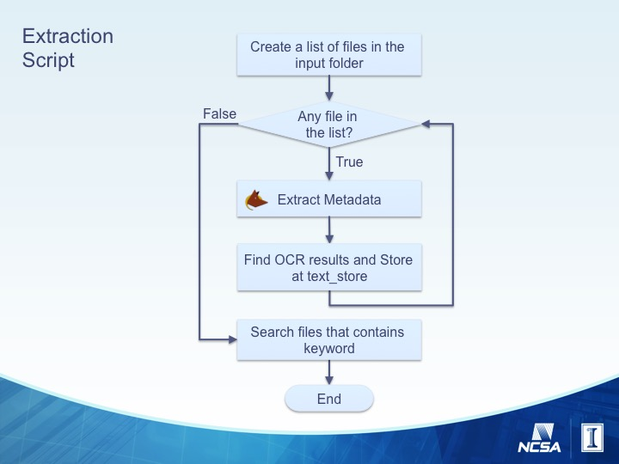
Code Overview - Main
Loop through files
Run Extraction on File
Search the returned metadata.
Loop through all metadata objects in metadata.jsonld for ocr_simple.
Use findItem function (above in script).
Get files from input directory, ignore folders
Search each files OCR results for ‘information’ using search function (above in script).

Slide 7
Search Functions
Function that searches every file’s OCR results for the seach term – in our example ‘information’.
Recursive function that searches a metadata object for a given key.

Slide 8
Get Started with Hands-On
Obtain a token if you have not already and login to VM
Go to the Extraction example
cd /home/ubuntu/git/bd-tutorial-problems/05-Extractions
Open the script for editing
nano extract-ex.py

Slide 9
Add Token and Files’ Path
token=“e474f26b-3102-41e9-90f3-fd38cee9faf1”
input_path=“/home/ubuntu/git/samplefiles/extraction”

Slide 10
Finish Main Routine
metadata = bd.extract(bds, input_file, token, 120)
Add one line of code that uses the search function above to search for the term ‘information’ and prints the result.
Add 4 lines of code that loop through the metadata[‘metadata.jsonld’] objects and searches each for the key ‘ocr_simple’ and adds any results to text_store.
print search(text_store, 'information')
Add one line of code here that runs the extraction.
Hint: use a bd.py function bd.extract(args)
for m in metadata['metadata.jsonld']:
txt = findItem(m, 'ocr_simple')
if not (txt is None):
text_store[basename(input_file)] = txt

Slide 11
Finish the Script – Search Function
def search(values, searchFor):
found = []
for k in values:
for v in values[k]:
if searchFor in v.lower():
found.append(k)
return found
Add four lines of code here that searches the metadata for your search term.
Hint: use two loops: the first steps through the metadata for each file, the second for the seach term within that file’s OCR text.

Slide 12
Close and Save File with Nano
Save extract-ex.py
^X
Y
<enter>

Slide 13
Run Script
Run Script and View Output

Slide 14
Verify Images - computerworld_conver.png

Slide 15
Verify Images – ncsa.jpg

Slide 16
Thanks

